Slide 1

Frontline Technology Summit
Topic: Session 2: Supply Chain Orchestration & AI
Dean Jackson
Mygo Consulting, Inc.
VP Strategic Partnerships and Enablement
Notes:
"Good morning, everyone. I’m Dean Jackson, VP of Strategic Partnerships and Enablement at Mygo Consulting. Welcome to the Frontline Technology Summit. Today, we're tackling a massive shift in our industry, and specifically, the IT leader's role in it.”
Our focus today is Supply Chain Orchestration & AI.
Business users are currently hyper-focused on basic, consumer-grade chatbots. Our job in IT is to guide our organizations beyond that. We need to show them how to build closed-source, enterprise-integrated AI systems. We want to leverage live warehouse data to autonomously orchestrate operations and proactively resolve bottlenecks."

Slide 2
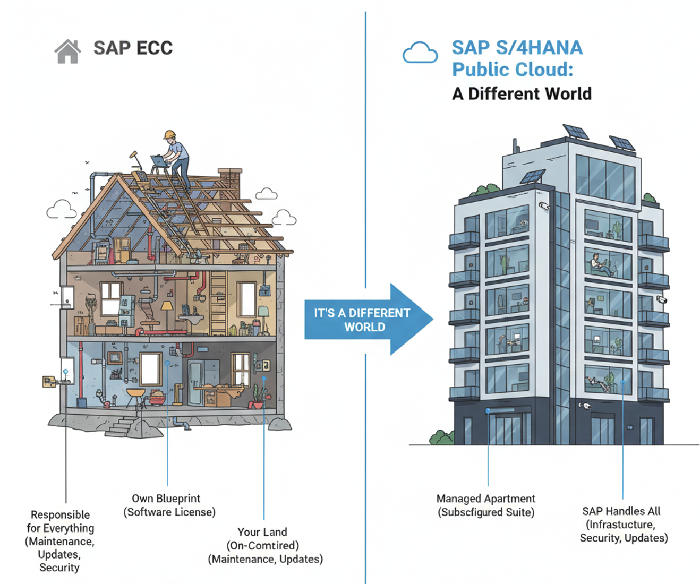
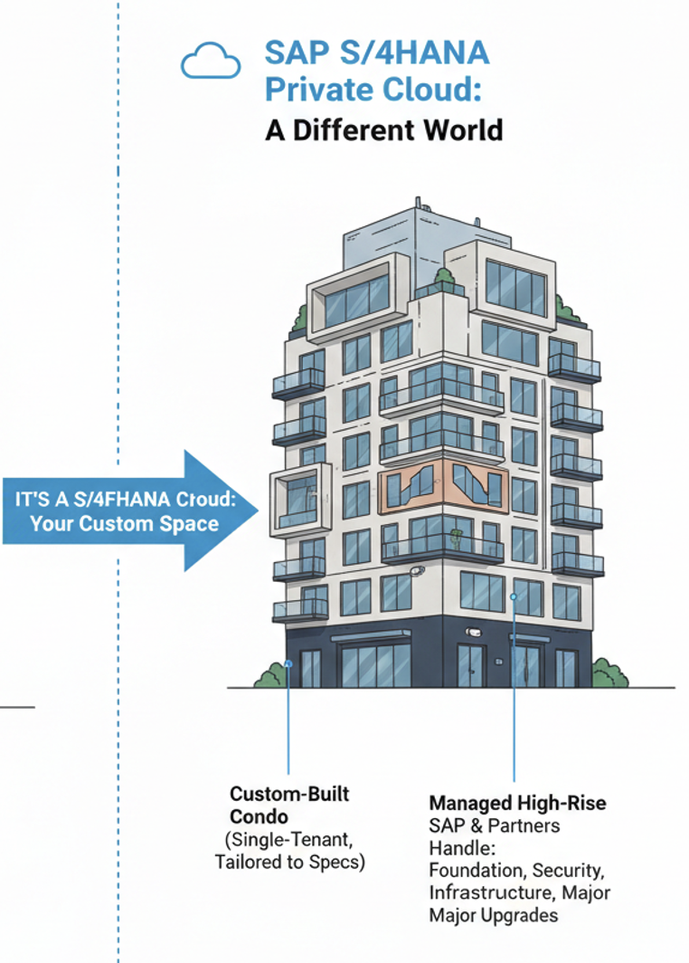
MIGRATION
On Premises
Public Cloud
Private Cloud
42%
Notes:
"Before we talk about the 'smart' stuff, we have to talk about the foundation.
Transitioning to the new Cloud Business AI Commercial Model is a literal paradigm shift.
Think of legacy SAP ECC like owning a standalone house—you own the blueprint, but you are responsible for everything from the plumbing to the roof maintenance.
Moving to S/4HANA Public Cloud is like moving into a managed apartment building; SAP handles the infrastructure, security, and updates.
S/4HANA Private Cloud is your custom-built condo within a managed high-rise.
Currently, we see a heavy split across On-Premises, Public Cloud, and Private Cloud environments. To build secure AI, we have to understand which 'building' our data lives in

Slide 3


HOW?
How can I Intelligently Teach the Business How to Turn Data Into Actionable Warehouse Insights ?
Notes:
The "No AI" Elephant in the Room
"So, how do we intelligently teach the business to turn data into actionable warehouse insights?
[Pause on the No AI sign] > We start by acknowledging the fear. The business is terrified of data leaks, hallucinations, and robots making bad decisions.
Our job isn't to force AI on them; it's to give them a vocabulary and a framework to control it."

Slide 4
10
AI WORDS
THEY NEED TO KNOW
1. Parameter
6. GPT
2. Training Data
7. Inference
3. Hallucination
8. RAG
4. Token
9. MCP
5. Open Source
10. Agents
Notes:
"To stop the fear, we must establish a common language. Here are the 10 words you must teach your business stakeholders:
1. Parameter: The millions of dials that define how an AI thinks.
2. Training Data: The textbook the AI studied before you met it.
3. Hallucination: When AI confidently states something totally wrong.
4. Token: The unit of text that AI reads and processes.
5. Open Source: AI models where the code and weights are publicly available.
6. GPT: Generative Pre-trained Transformer—the architecture behind modern AI.
7. Inference: Running the AI to generate a response—the actual 'using' phase. 8. RAG: Retrieval-Augmented Generation. This is crucial—it's how we give AI access to real, live documents.
9. MCP: Model Context Protocol. Think of this as the standard plug-in system for AI tools.
10. Agents: AI that can autonomously take actions to complete multi-step goals."

Slide 5
1 to 5 - AI WORDS
1. Parameter - The millions of dials that define how an AI thinks
2. Training Data – This is the textbook the AI studied before you met it
3. Hallucination - When AI confidently states something totally wrong
4. Token - The unit of text that AI reads and processes
5. Open Source - AI models whose code and weights are publicly available
Notes:
Parameter:
Parameters are numerical values stored inside the AI model
They are set during training — not during your chat session
More parameters generally means more capable (and more expensive) AI
Example: 'A 70B model' means 70 billion parameters
Training Data
Before ChatGPT could chat with you, it read enormous amounts of text — books, web pages, source code, conversations — to learn patterns of language
Books, Wikipedia articles, academic papers
Billions of web pages scraped from the internet
Source code from GitHub and other repositories
Online conversations and Q&A forums
Hallucination
AI doesn't "look up" facts — it predicts the most likely-sounding answer. Sometimes it's wrong but sounds totally confident. Like a student who guesses boldly on every question.
AI generates the statistically probable next word, not verified truth
It has no real-time connection to a "truth database"
High confidence ≠ high accuracy — always verify important claims
Tip: Ask AI to cite sources or say 'I'm not sure' when uncertain
Token
Understanding AI is simple" = 5 tokens. Tokens are word pieces — usually a word or part of a word. Your context window (128K tokens) is like your desk size: it limits how much the AI can "see" at once.
~1 token ≈ ¾ of a word in English
"ChatGPT" = 1 token; "Hallucination" = 3 tokens
Context window = maximum tokens AI can hold in memory
More tokens = higher API cost (you pay per token)
Open Source - Closed source (GPT-4): a black box — controlled by a company, you can't see inside. Open source (Llama 2): full transparency — anyone can download, inspect, modify, and run the model.
Closed source: OpenAI's GPT-4, Anthropic's Claude — API access only
Open source: Meta's Llama, Mistral — download and self-host
Open source = community-driven innovation and full transparency
Trade-off: open source requires your own compute & maintenance

Slide 6
6 to 10 - AI WORDS
6. GPT – Gen-er-ative Pre-trained Transformer — the architecture behind modern AI
7. Inference. - Running the AI to generate a response — the 'using' phase
8. RAG - Retrieval-Augmented Generation — giving AI access to real documents
9. MCP. - Model Context Protocol — a standard plug-in system for AI tools
10. Agents- AI that takes actions autonomously to complete multi-step goals
Notes:
GPT
GPT stands for three key ideas: it Generates text, it was Pre-trained on massive datasets, and it uses a Transformer architecture to understand context across long passages.
Generative: it produces (generates) new text
Pre-trained: trained once on huge data, then fine-tuned for tasks
Transformer: a neural network design that processes all words at once
GPT is an architecture — ChatGPT is a product built on top of it
Iference
Training = student studying for years. Inference = student answering your question in real-time. Every time you send a message, the AI runs inference to predict and return a response.
Training: expensive, done once, adjusts all the parameters
Inference: fast, runs every time you prompt the model
Inference cost is why AI APIs charge per token
Local inference = running the model on your own hardware
RAG - Imagine an AI that, before answering, can search a filing cabinet of your documents and pull out the relevant pages. RAG = Retrieval (search) + Augmented (enhanced) + Generation (AI writes the answer).
Your documents are converted into searchable vector embeddings
When you ask a question, relevant chunks are retrieved first
The AI uses those chunks as context to generate a grounded answer
Solves hallucination for domain-specific knowledge (manuals, contracts, etc.)
MCP. - Think of MCP like USB for AI. Just as USB lets any device plug into any computer with a standard connector, MCP lets any AI connect to any tool — databases, calendars, APIs — using one universal standard.
Created by Anthropic as an open standard for AI-tool integration
Replaces one-off custom integrations with a single universal protocol
Enables AI to read files, query databases, call APIs, and browse the web
Any developer can build an MCP server; any AI client can connect to it
AGENTS- A chatbot answers questions. An agent actually does things — it plans steps, uses tools, browses the web, writes and runs code, and loops until the task is complete. It's the difference between giving advice and doing the work.
Can use tools: web search, code execution, file management, APIs
Plans and executes multi-step workflows without hand-holding
Can spawn sub-agents to parallelize complex tasks
Requires careful oversight — agents can make real-world changes
Agents -

Slide 7
WHAT DATA DOES AI READ FROM THE WMS?
Joule connects directly to your live EWM system via RAG — no data leaves SAP
🚚 Transfer Orders
📋 Delivery Documents
📦 Handling Units
· Planned start & end times
· Requested delivery date
· Items picked (qty vs ordered)
· Actual completion times
· Goods issue posted (Y/N)
· HU packed & loaded status
· Warehouse task status
· Shipping point & route
· Carrier confirmed (Y/N)
· Picker / resource assigned
· Customer & PO reference
· Proof of despatch
🏷️ Resource Status
⏱️ Wave & Queue Data
🔔 System Exception Logs
· Forklift / dock assignments
· Wave release time
· Transfer order errors
· Resource locked / glitched flags
· Pick queue backlog
· Resource conflict flags
· Queue depth per resource
· Avg pick rate per hour
· Unconfirmed TO age > threshold
· Last activity timestamp
· Estimated completion vs plan
· WM error messages
Notes:
Grounding AI in Reality (WMS Data)
Visual: Breakdown of WMS data (Transfer Orders, Delivery Docs, Handling Units, etc.).
Speaker Notes:
"Once they know the words, we show them the data.
What does an enterprise AI actually read?
Tools like Joule connect directly to your live EWM system via RAG, meaning no data ever leaves SAP.
It's looking at planned and actual times on Transfer Orders, requested delivery dates on Delivery Documents, carrier confirmation on Handling Units, forklift queue depths, and critical system exception logs."

Slide 8
Company’s AI vs ChatGPT
Both use GPT-style AI — but they are built for very different purposes
CompanyAI
ChatGPT / Public AI
Data source
✅ YOUR live Company data
· General internet training data
Data privacy
✅ Fully private — stays in the company
· Inputs may be used for training
Source code
✅ Closed — Company controlled
· Closed (GPT-4) or Open (others)
Business context
✅ Knows business processes & your org
· Generic — no SAP knowledge
Access control
✅ Respects your authorizations
· No enterprise access controls
Support & SLA
✅ Full enterprise support
· Consumer / developer tiers only
Compliance
✅ GDPR, industry certified
· Varies — user's responsibility
Notes:
"This slide is your ultimate weapon against stakeholder anxiety.
Both might use GPT-style architecture, but they are built for entirely different purposes.
ChatGPT runs on general internet data, and your inputs might be used for future training. Furthermore, it has no enterprise access controls.
Enterprise AI, however, runs on YOUR live company data. It is fully private, respects your authorizations, knows your business processes, and is GDPR compliant."

Slide 9
WRITE THE FIRST BRIEF
Every business problem worth solving deserves a brief. Here is how to start today.
🧑‍💼 MANAGER
📋 BUSINESS ANALYST
💻 WORKING WITH IT
1. Pick ONE problem your team deals with every week
1. Take the manager's pain statement and map it your AI Requirements:
1. Share the completed brief within the IT design session
2. Write— THE PAIN in plain English
2. Create a RAG for all GI, and DO in the system
2. Use the Red Flag questions if IT's answers feel vague
3. Estimate: how often does it happen and what does it cost?
3. You need an Agent to review all open DO in the systems for TM Users.
3. Agree which AI keywords each solution component maps to
4. Ask your BA to complete the rest of the brief with you
4. Parameter should have guardrails with input of dispatch time, day and SLA
4. Insist on seeing the guardrails and audit trail in the first demo
5. Come to the next IT meeting with the brief — not a complaint
5. The Agent can take action and or send alerts for approvals.
5. Sign off on the test scenario using a real example from your operation
Your job: SPOT & DESCRIBE
Your job: SHAPE & CHALLENGE
Your job: VALIDATE & SIGN OFF
"You now speak AI. You know the problem. You have the framework. The only thing left is to write the brief."
Notes:
"Every business problem worth solving deserves a brief. Here is how you instruct your teams to collaborate:
Managers: Your job is to SPOT & DESCRIBE. Pick one pain point, explain it in plain English, estimate its cost, and bring a brief—not a complaint—to IT.
Business Analysts: Your job is to SHAPE & CHALLENGE. Map that pain to AI requirements, define the RAG sources, parameter guardrails, and agent SLAs.
Working with IT: Your job is to VALIDATE & SIGN OFF. Agree on which keywords map to the solution, insist on seeing audit trails in the first demo, and test with real operational examples."

Slide 10
EWM KPI / ON-TIME-IN-FULL (OTIF)
AI calculates OTIF in real-time from EWM delivery and goods issue data
📐 OTIF Definition:
ON-TIME = Goods Issue posted on or before the Requested Delivery Date | IN-FULL = All ordered quantities picked, packed & shipped with no shortages
TODAY'S OTIF
LATE SHIPMENTS
SHORT SHIPMENTS
⚠️ 87.3%
🔴 14
⚠️ 6
↓ 4.2% vs yesterday
out of 112 today
incomplete picks
💬 WHAT JOULE ACTUALLY SAYS:
👤 Manager:
”Hey AI, what is our OTIF performance today and which shipments are at risk?"
🤖 Ai Said:
"Your OTIF today is 87.3% — below the 95% target. 14 shipments missed the delivery window; 6 have quantity shortages. Top risk: Shipping Point DE01, where 9 late deliveries share route EU-WEST. I can show you the affected DOs or draft a carrier alert — which would you prefer?"
Notes:
"Let's look at a practical EWM example: On-Time-In-Full (OTIF).
Instead of a manager hunting through tables because OTIF dropped 4.2% today, they just ask the AI.
[Read Joule's response] Joule doesn't just give the number; it identifies that 14 shipments missed the window, pinpoints Shipping Point DE01 as the primary risk, and immediately offers to draft a carrier alert.
That is proactive orchestration."

Slide 11
PROBLEM: "STOCK ON RESOURCES" SHIPMENTS
When a system glitch locks a resource, shipments pile up silently — Joule spots this before it becomes a crisis
⚠️ What ‘Stock on Resource' Means
✅ How AI Detects It
1. A Transfer Order is assigned to a resource (forklift, dock, printer)
✓ Monitors TO age — flags TOs unconfirmed beyond threshold (e.g. 30 min)
2. Resource has a system error or lock — cannot process the TO
✓ Checks resource status log — identifies error codes on assigned resource
3. The TO sits queued indefinitely — no alert is raised
✓ Cross-checks other TOs on same resource — spots systemic glitch pattern
4. Shipment misses the loading window → late despatch → OTIF hit
✓ Raises proactive alert to shift manager before the delivery window closes
🚨 AI PROACTIVE ALERT — What Joule pushes to the manager:
🔴 AI ALERT — 14:23
"3 Transfer Orders have been stuck on Forklift Resource FLT-07 (Dock 4) for 47 minutes. Error code WM-301 detected on this resource. These TOs cover Delivery Orders 4500112, 4500118, 4500124 — all due for despatch by 15:00. At current status, all 3 will miss the cut-off. Suggested actions: ① Re-assign TOs to FLT-09 (available, same zone) ② Log IT ticket for FLT-07 ③ Notify carrier of potential delay."
⚡ AI CAN TRIGGER (with manager approval):
🔁
🎫
📧
📊
📝
Re-assign TOs
to FLT-09
Auto-raise
IT incident
Email carrier
delay notice
Update OTIF
dashboard
Log exception
in audit trail
Notes:
Visual: Explain how glitches lock resources and how AI detects and resolves it.
Speaker Notes:
"Let's take it a step further to autonomous agents.
Consider a 'Stock on Resource' error, where a forklift glitches and a transfer order sits indefinitely, silently killing your OTIF.
AI detects this by monitoring TO age against thresholds and checking resource error codes.
It sends a proactive alert before the cutoff. With a simple manager approval, the AI Agent can autonomously re-assign the order to an available forklift, auto-raise an IT incident, and log the exception in the audit trail."

Slide 12
BACK TO BASICS
Every AI Use Case Brief maps directly to these 10 concepts — each one tells IT something specific about what to build
Parameter
WHAT IT CONFIGURES
Training Data
WHAT IT KNOWS
What thresholds, rules or values should the AI use?
What SAP data, process docs or rules should Joule be trained on?
e.g. 'Flag any TO open on a resource for more than 20 minutes'
e.g. 'EWM transfer order history, resource logs, delivery data'
Hallucination
WHAT IT MUST NOT DO
Token
HOW YOU TALK TO IT
Where must Joule never guess? What answers need to be grounded in real data?
How should the business phrase prompts to get the best results?
e.g. 'Never invent a stock location — always retrieve from EWM live'
e.g. 'Ask precisely: Delivery Order, date, shipping point'
Open Source
HOW IT'S BUILT
GPT
WHAT POWERS IT
Is this using SAP's closed Joule model, or an open-source component?
Which AI model architecture handles this use case?
e.g. 'Joule only — no external models touch our data'
e.g. 'Joule uses GPT-style inference on SAP's closed platform'
Inference
WHEN IT RUNS
RAG
WHERE IT GETS FACTS
Does Joule answer on-demand, or does it monitor continuously?
Which live SAP data sources does Joule retrieve from to answer?
e.g. 'Continuous monitoring — alert triggered, not prompted'
e.g. 'EWM exception log, TO table, delivery header, dock activity'
MCP
WHAT IT CONNECTS TO
Agents
WHAT IT DOES
Which SAP modules and external tools does Joule need to plug into?
Should Joule just alert — or should it take actions autonomously?
e.g. 'EWM + S/4HANA SD + carrier notification API'
e.g. 'Post retroactive TO confirmation with manager approval'
Notes:
Visual: The 10 AI words mapped to the Use Case Brief.
Speaker Notes:
"As an IT team, you use the 10 words we taught the business to translate their brief into architecture.
Parameter tells us what thresholds to configure.
* Training Data and RAG tell us where the AI gets its facts.
* Hallucination defines our strict boundaries—what it must NEVER do.
* MCP outlines the integrations, and Agents define the autonomous actions we need to code."

Slide 13





Stop Chatting. Start Building. See Things Differently
The 5-layer stack separating AI users from AI builders
01
02
03
04
05
Tool Use
Skills
Context
Workflows
Platform
Give AI hands — Jira, WMS, HCM, TM, CRM connectors, computer control
A full recipe: your brand, tone, and instructions in one reusable file
Feed AI your actual files. Right context beats a smarter model every time
Chain 10 steps into one command. Systems run without you
AI Desktop & AI Code — where tools, skills, and context actually live
Learning this is not optional anymore. The gap between chatters and builders widens every week.
Notes:
Visual: The 5-layer AI stack.
Speaker Notes:
"I'll leave you with this. T
he gap between organizations that just 'chat' with AI and those that 'build' with it is widening every single week.
To be builders, we must master the 5-layer stack: giving AI Tools to use, defining reusable Skills, feeding it the right Context, chaining those into autonomous Workflows, and deploying it all on a secure enterprise Platform. Let's go teach the business how to build.
Thank you."

Slide 14
Thank you!

