Slide 1



FRONTLINE TECHNOLOGY SUMMIT
Topic: The North Star
Jordan Roberts
Connors Group
Account Manager
jroberts@connorsllc.com
(724) 470-7484
April 8th 2026

Slide 2
Frontline Technology Summit
Topic: Session 1:
Notes:
"Good morning, everyone. I’m Dean Jackson, VP of Strategic Partnerships and Enablement at Mygo Consulting. Welcome to the Frontline Technology Summit. Today, we're tackling a massive shift in our industry, and specifically, the IT leader's role in it.”
Our focus today is Supply Chain Orchestration & AI.
Business users are currently hyper-focused on basic, consumer-grade chatbots. Our job in IT is to guide our organizations beyond that. We need to show them how to build closed-source, enterprise-integrated AI systems. We want to leverage live warehouse data to autonomously orchestrate operations and proactively resolve bottlenecks."

Slide 3

Aligning IT Objectives with Labor Standards to Drive Measurable Performance

Slide 4
What You’ll Walk Away With
Align IT, Labor Standards, and Leadership into a Single Performance System
Outcomes:
Define a clear North Star for workforce performance
Understand where IT and labor standards connect (and break)
Apply a roadmap to move from tools to execution to results
Notes:
“If I do this right, you’ll leave with something you can actually use next week”

Slide 5
The Problem We’re Solving
Disconnected Systems Drive Inconsistent Performance
IT investments increasing
Labor expectations unclear or outdated
Leadership execution inconsistent
Turnover is higher than ever before
Standards
Leadership
IT
Bottom Line:
Performance is not always translating to results
Notes:
“Most Organizations don’t have a technology gap – they have a connection gap”

Slide 6
Labor Management Landscape
Disconnected Systems Drive Inconsistent Performance
Fast Facts
55%
150
$150k
Labor as % of Total Cost
Avg Employee per Site
Average LM System Investment
45%
$5k
$35k
Avg Turnover Rate
Average Turnover Cost per Employee
Average Turnover Cost per Manager
Notes:
“Most Organizations don’t have a technology gap – they have a connection gap”

Slide 7
North Star = “What Good Looks Like”

Slide 8
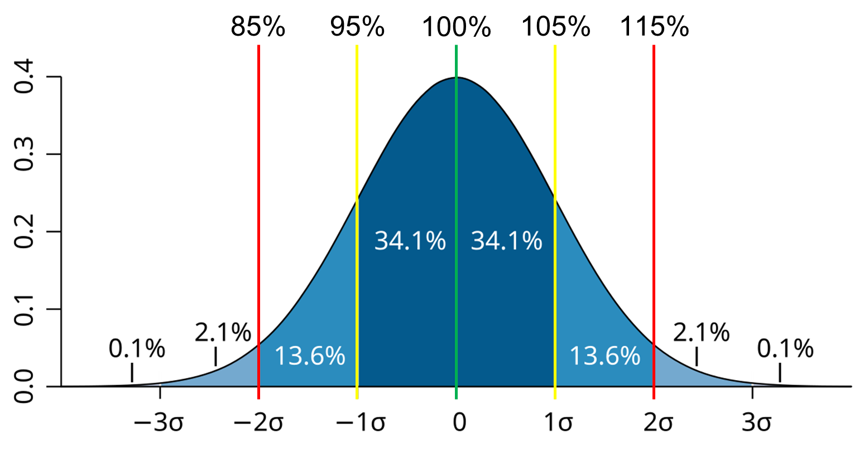
What is the North Star?
A Shared Definition of “What Good Looks Like”
Labor standard = average worker working at a normal pace with a prescribed method
Performance = standard time / actual time
Utilization = direct Time / total Time
Effectiveness = utilization x performance
Visibility = real-time and actionable
LM Health Check - Performance
Notes:
“This is your Labor Management philosophy and what everything should align to and support”

Slide 9
The Compass
N
Systems are the Map; Standards are the Compass
IT systems show where you are
Standards define where you should be
W
E
S
Notes:
“Most companies have a map…very few have a compass - Without both, direction is lost and performance suffers”

Slide 10
The Integration Model
Three Components of Performance
IT Systems (LM, WMS, WFM)
Leadership Operating System (LSW)
Labor Standards
Define expectations
(process)
Measure performance
(technology)
Drive action
(people)
Notes:
Without any one of the 3 the system fails. Most people get the technology, some get the standards, few layer on the leadership to drive action.

Slide 11
Standards Define it. Systems Measure it. Leaders Make it Happen.

Slide 12
Where IT and Labor Standards Connect (And Break)

Slide 13
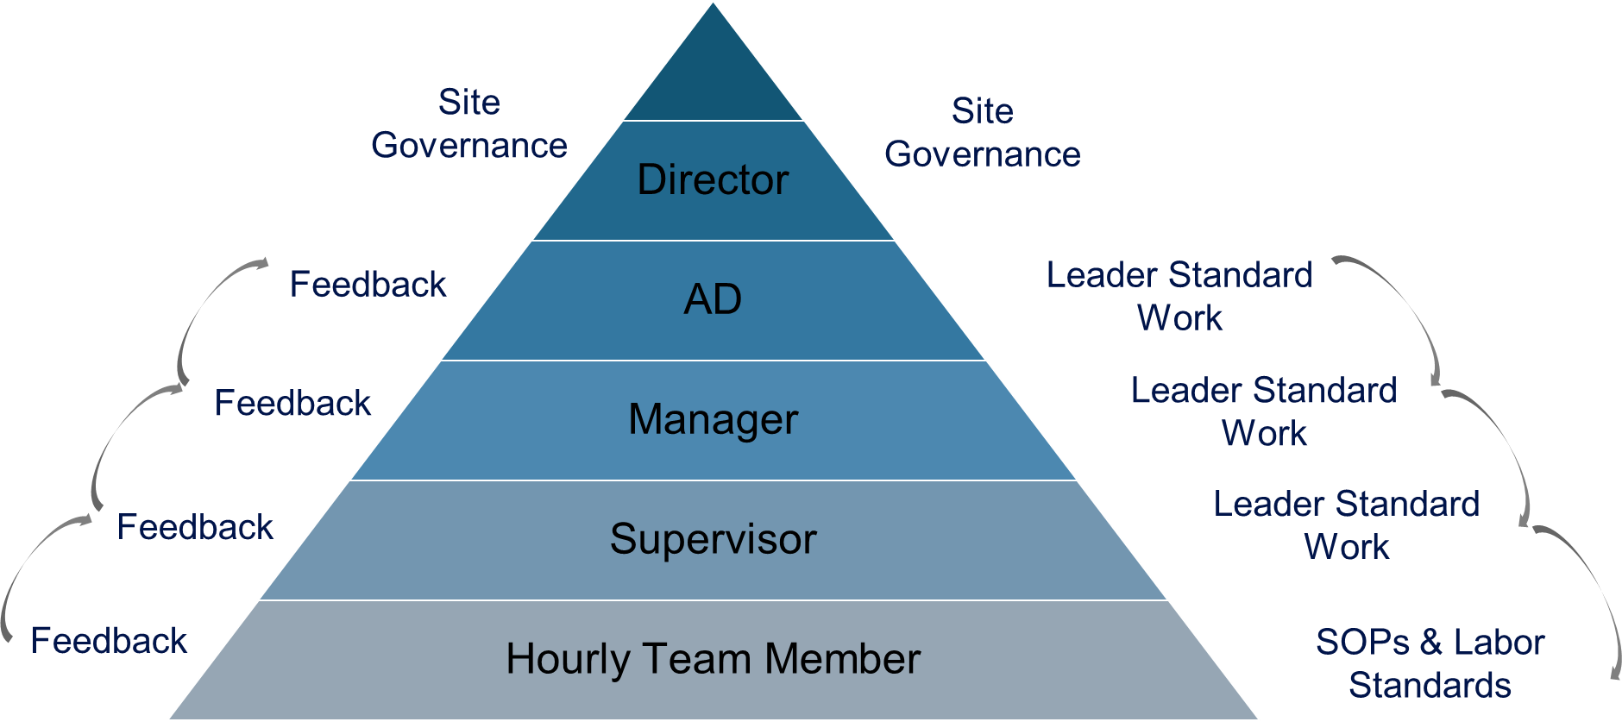
What Good Looks Like
Aligned Performance Systems
Standards embedded in systems
Real-time visibility across roles
Leader routines tied to business metrics
Clear accountability at every level
Governance to support continuous improvement
Notes:
“Most companies have a map…very few have a compass”

Slide 14
Most Organizations Don’t Have a Labor Problem
They Have an Alignment Problem
Significant investments are being made in IT systems
Limited adoption and impact
Execution breaks at the front line
Notes:
“this is where most people lean in”

Slide 15
What Looks Right
(But Isn’t)
Looks Right
But…
Missing
LM tool selected
Standards documented
LM implemented
Dashboards in place
No Leader Standard Work
No coaching cadence
No accountability system
No governance to sustain system or process changes
Notes:
“This should feel familiar”

Slide 16
You Didn’t Implement Labor Management. You Installed a Reporting Tool.

Slide 17

What Happens Next?
When the System isn’t Complete…
Metrics become noise
Supervisors disengage
Associates lose trust
ROI never materializes
Notes:
“Tie this to examples – LT Apparel.”

Slide 18
Near Miss vs. North Star
Near Miss | North Star
Reports | Actions
Visibility | Accountability
Metrics | Behavior Change
Tools | Operating System
Notes:
“This is the shift we’re trying to make.”

Slide 19
How to Move From Tools to Execution to Results

Slide 20
Example: Before
Common Starting Point…
LM system in place for 8 years
Standards outdated and didn’t reflect the processes at the new facility
No governance to sustain process changes
Limited supervisor engagement – only using gap time reporting with inconsistent coaching and intervention
Lack of LM training across all sites
Overall LM performance was at 74%

Slide 21
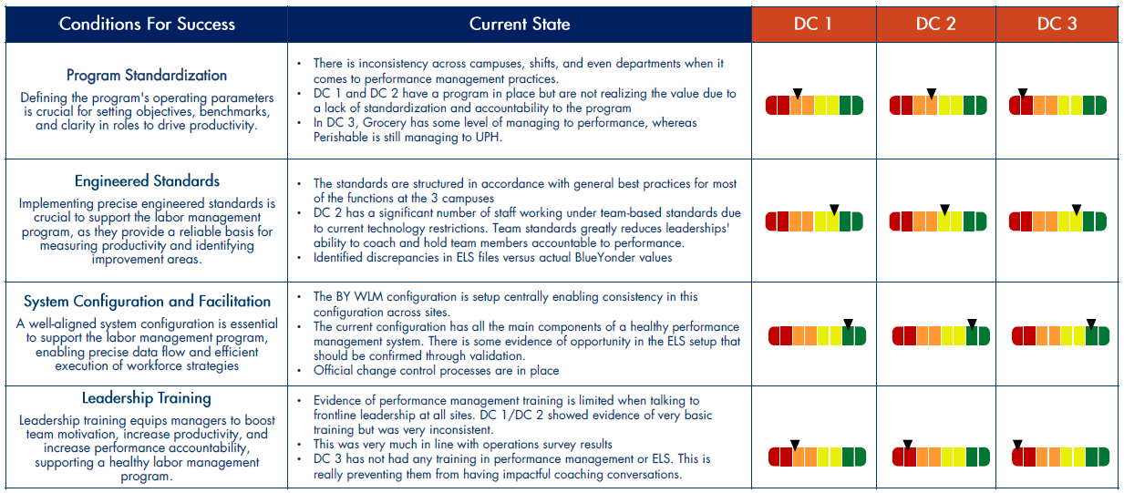
Example: What Changed
Identified Gaps and Created a Labor Management System
Started with an LM assessment to size the opportunity
Validated methods and rebuilt standards to match work
Configured updated standards into LM system
Developed Leader Standard Work to drive a cadence for action and follow up
Completed operations and IE training
Notes:
“Focus on behavior + system, not tools”

Slide 22
Example: Results
System Alignment
~10% increase in performance in first year
Increased employee engagement
Consistent execution across sites
Framework for onboarding new employees
Labor Opportunity
$16M-$18M
$14M-$16M
20M
15M
10M
5M
 | Current 74% Performance | IBEGIN GAP Reduction | @ 80% Performance | @ 90% Performance | @ 95% Performance | @ 100% Performance
$9M-$10M
$6M-$7M
$2M-$2.5M
Notes:
“Sites that embraced the system realized results.”

Slide 23
The Roadmap
Phase 1 - Crawl
Phase 2 - Walk
Phase 3 - Run
Align the Foundation
Integrate Systems
Performance Culture
Methods & SOPs
Reasonable expectations
Staffing & scheduling
Onboarding & training
Demand forecasting
Engineered labor standards
LM go live (WMS, LMS, and WFM connected)
Coaching culture
Leader Standard Work
Conditions for success
Employee engagement
Accountability and incentive programs
Continuous improvement
Customized reporting
System maintenance and governance
Notes:
“Sites that embraced the system realized results.”

Slide 24
3 Things to Remember
Key Takeaways
Most organizations don’t have a labor problem they have an alignment problem between people, process, and technology
Technology is the map and labor standards are the compass
Don’t fall into the reporting tool trap - Leaders ultimately drive results with the right system structure
1
2
3

Slide 25
Final Thought
What You Have Now
A clear definition of the North Star
A framework to align people (leadership), process (standards), and Technology (IT)
A roadmap to move from tools to execution to results
Technology should be aligned to support leaders in driving performance.

Slide 26
Thank you!

