Slide 1


ZEBRA EXPERIENCE CENTER | LINCOLNSHIRE, IL
The Missing Signal in Your Operations
Visibility, people, and winning by seeing things differently.
Shari Christofferson - Connect Inc
Notes:
"By the end of this discussion, we're all going to find we have a lot in common with Billy Beane — aside from being so good-looking that Brad Pitt plays us on the big screen."
"What Billy figured out wasn't about baseball. It was about seeing what everyone else was ignoring. Measuring what actually drives outcomes. And winning with information that was always there — just never organized."
In 2002, the Oakland A's had a $41M payroll. The Yankees had $125M.
Billy Beane didn't find a way to spend more. He found a way to see more — specifically, to see what everyone else was missing in the data they already had.
The scouting establishment watched games and trusted their eyes. Beane asked: what actually predicts winning?
The answer wasn't batting average. It was on-base percentage. A number everyone had — and almost nobody was using.
"The gap wasn't in the information. It was in knowing which signal to trust."
Warehouses have the same problem.

Slide 2


The Feedback Deficit
We've digitized feedback everywhere — except the warehouse floor.
Customer Experience
Employee Engagement
Field Service
How does a picker report that their gun is slow? → They tell their supervisor. Maybe.
How does IT know that workers on Shift 3 are struggling? → They don't. Until a ticket arrives.
How does leadership know that workarounds are masking system failures? → They probably don't.
The warehouse floor is the last major operational environment without a structured feedback loop.
Notes:
The missing signal is the digital feedback deficit.
Like an NPS score, the employee survey or the field technician survey - where is that same signal coming from the DC or manufacturing floor?
The irony!

Slide 3


The Silo Problem
MDM Tools
Device data — health events, battery status, connectivity — locked inside mobile device management platforms
Infrastructure Dashboards
Network data — access point performance, signal strength, latency — siloed in infrastructure tools
WMS / ERP Logs
Application logs — error codes, transaction times, system events — buried in enterprise platforms
AMR Platform
Robot telemetry — path data, task completion, collision events — isolated in the robotics ecosystem
You have the data. It's just in four different rooms, in four different languages, owned by four different teams.
Notes:
IT data exists. It's just trapped. Every mobile device, access point, application server, and robot in your DC generates data continuously.
Maybe you have AI agent to pull all the data from all these various signals and align on a timestamp. OK< but what does that get you without ground proof?
I will share some examples.

Slide 4


What Losing Looks Like
Three ways the gap between your data layers shows up as real money.
+1.2M in labor, IT
+2M each year
+600,000 sunk costs
The Long Tail of Unresolved Issues
IT Spend on the Wrong Things
Inability to Scale or Advance
The robot graveyard in the corner of the DC. The new mobile computers that mysterious don’t seem to work in 5 of the 10 DCs.
AI projects that lacked the complete data sets.
Intermittent problems that get logged, escalated, and never solved. Some go on for 6, 12, even 18 months.
Technology cycles based on age, not behavior. Network upgrades that don't address the actual bottleneck.
Notes:
Intermittent problems that get logged, escalated, and never solved. Some go on for 6, 12, even 18 months. When the user reporting is installed and the silos are broken down – turns out there are 3 problems, all fixable.
Rip and replace. Access points, new mobile computers, software, etc. Scale. Entire teams tied up for months – until the next person complains.
Robots

Slide 5

What Would Change If You Looked At It Differently?
Real-Time Worker Feedback
Transaction-Level IT Visibility
Pickers can flag device or system friction in real time — not just via a supervisor conversation
IT can see device , network and application behavior at the transaction level, not just at the event level
Unified Timeline
Hours, Not Months
Operational KPIs and IT system data displayed on the same timeline — correlated automatically
Problems are identified in hours — not months. Proactive resolution before the ticket, before the complaint
The question is: do you have the visibility layer that connects these signals?
Notes:
Looked at It differently!
This isn't hypothetical. It's an architecture decision. The question is: do you have the visibility layer that connects these signals?

Slide 6



OUR STORY
Connect's Moneyball Moment
1992
Founded — Enabled global scaling of connected frontline workers from Chicago.
2018
The Pivot — Stopped watching logs. Started watching people.
NOW
MSI — combining IT systems performance analytics with frontline human experience.
Before 2018: Event-Based
After 2018: Experience + Problem Capture
THE STRATEGIC PLAY - Mobile Systems Intelligence
We gave the worker a voice. From any device, a frontline associate can report their experience in real time.
Notes:
• Connect has been in warehouse connectivity since 1992. We've supported the full evolution — RF terminals, handheld devices, voice systems, mobile computing, printers, RFID. Now AMRs, ASRS, and more.
Every new edge technology that came through the DC, we were there.
• And for most of those years, we did what everyone else did. We tracked the typical stats. Software logs. Network logs. Event-based alerts. A blinking yellow light. Then red. Then a ticket.
"We were good at it. But in 2018, we had a realization that changed everything."
• Every time we got called in to solve a problem, the alert wasn't where the problem started. The problem started earlier — invisibly — in the hands of the people doing the work.
• The old question: What did the system report?
• The new question: What is the frontline team actually experiencing — right now, at the transaction level?
"That's a completely different lens. And once you look through it, you can't go back."
• We built MSI — Mobile Systems Intelligence — around that frontline-first philosophy.
• MSI watches every transaction. Every scan. Every print job. Every application response. Continuously. That's the objective layer.
• But here's where it goes further — and further than most people expect:
THE DIFFERENTIATOR — THE BUTTON
• We gave the worker a button.
• On their mobile device, laptop, or desktop — a frontline associate can stop and say: something's not right. Here's what I'm experiencing right now. Not a help desk ticket. Not a supervisor conversation. Just direct, structured feedback from the floor.
"That's the subjective layer. And when you combine it with the objective transaction data we're already capturing — something powerful happens."
• You see where the human experience diverges from what the data says is fine. That gap — between a green system and a frustrated worker — is where the real problems live.
• Think about what that can mean in your operations.
if a worker on the goods-to-person line is experiencing lag that the network log doesn't flag, they now have a direct line to surface it. MSI correlates that feedback with transaction data, network performance, application response times, and edge device health — all at once.
"We don't just tell you the system is slow. We tell you which worker flagged it, on which device, on which application, against what the network was doing at that exact moment. That's a root cause, not a symptom."

Slide 7

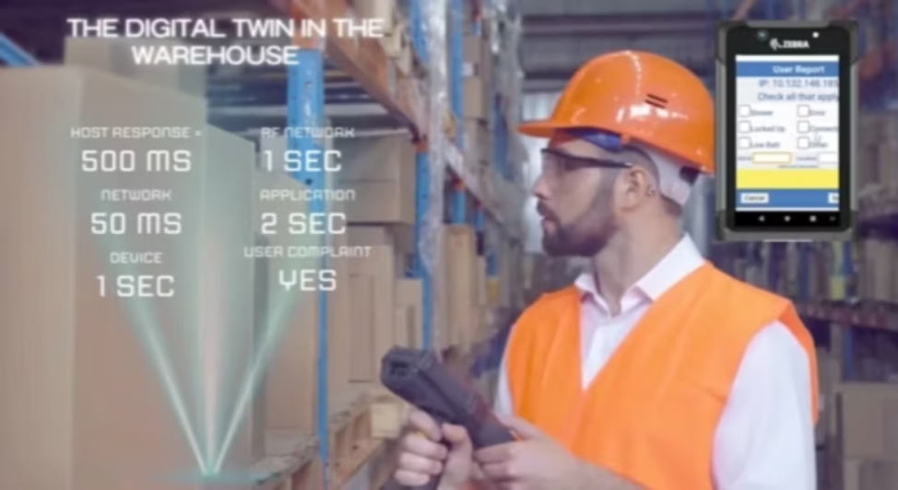
Enabling More Wins
Unified visibility. No more silos
Resolving the RIGHT problem with the correct vendors.
Automating complex systems analysis for accurate decision making
Digital feedback loop + Complete IT Record
Notes:
This approach results in more wins for our customers.
Example – less than halfway through a major mobile computer refresh – most DC’s don’t complain, a few do – it’s still too slow.
Software vendors was pushing the customer to buy all new device side software - easily a few hundred thousand dollars. The software vendor is being paid quite bit of money, the mobile deployment is worth over a million.
Without the strategic MSI data – this company would have had to do that. Instead – software vendor had to deal with their bug.

Slide 8
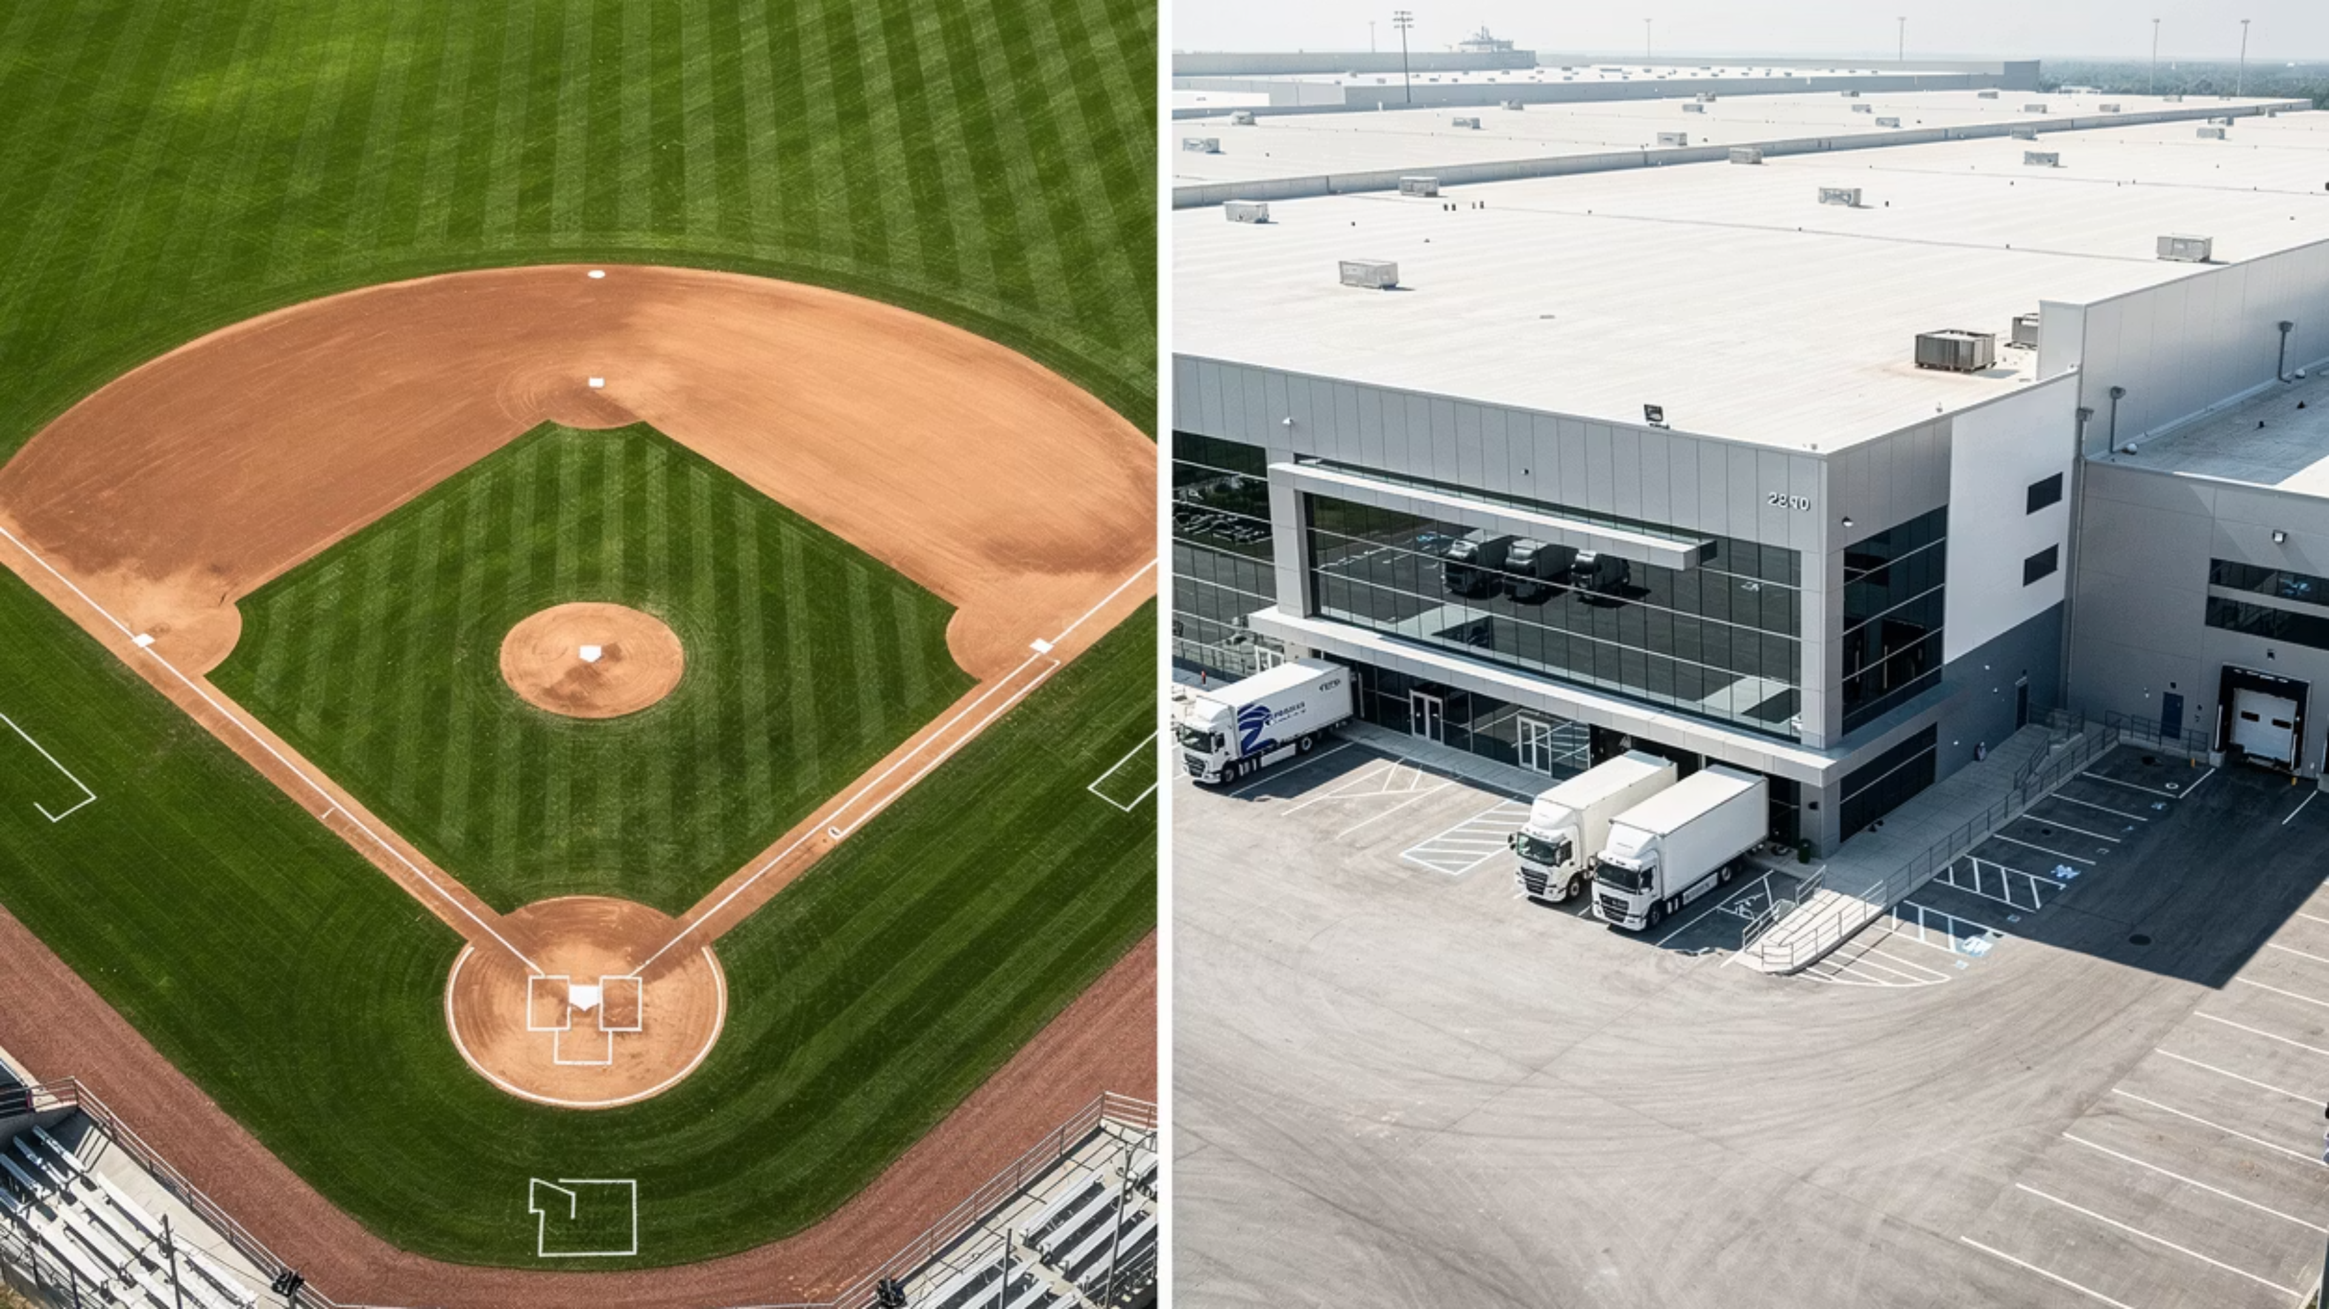

The Moneyball DC Sees Things Differently
Traditional Baseball Stats
Moneyball Tracks
Advantage
Batting AVG
wOBA - Weighted on-base avg adjusts for homers vs singles
Gives more context on the consistency of the type of hitter
Earned Runs Allowed (ERA)
Fielding Independent Pitching (FIP)
Bullpen management
What Most DC's Track
What IT Teams Track
Moneyball DC - MSI Metrics
Lines Picked / Hour (LPH)
WMS response time,
User's POV (WMS+networks+edge tech, plus sentiment)
Network monitors,
MDM state of hardware, software
Labor Utilization Rate
Server utilization, network uptime
System Interrupt rate - where, when, why systems break the workflow per edge/worker.
Engineered Labor Standards (ELS)
% end to end transactions over ELS per user and per site or custom groups
Turnover Rate
Sentiment Drift - User reporting volume or a decrease in reporting when diagnosed problems persist.
Notes:
Back to the Moneyball lens.
By taking this new approach, of starting with user's sentiment and directly linking that to the logging of systems involved in creating that operators experience, we now have a more advantageous method of finding and fixing problems, directly vs indirectly.
The feedback and analysis of each edge device when they are in the game - that is when they are exchanging data over networks to back-end servers - gives us the play by play and we can then create - STATS
STATS that tie to real outcomes for DC's and are usable by IT and Operations.
Here's how the Moneyball DC STATS relate.

Slide 9






YOUR USE CASES
The Game Plan
1 — Know Your Baseline
2 — Support & Optimization
3 — Facts vs. Fear
What should the new system be able to handle and deliver
Frontline sentiment from where they stand today
Your Moneyball stats before anything changes
Real-time visibility across all vendors
Worker inputs correlated with system data
Isolate failure to exact transaction
Crisis → managed incident
Is pushback change management or real?
Pre/post migration data side by side
Objective truth on system improvement
Institutional knowledge that grows with you
The baseline you build before technology change informs everything you see during it and after it.
Notes:
• Before you change anything — you need to know what you actually have. What is happening on your floor, on your systems, in your workers' hands, right now.
That baseline is everything. Without it, you can't answer the most important migration question: is this new system actually better — or does it just feel different?
What are the Moneyball stats today? Then we track them through the change.
"Think of it as your pre-season scouting report. You don't walk into the draft without knowing what your roster actually looks like right now."
DURING: Getting the Kinks Out
"The question isn't whether something will surface. The question is: how fast will you know, how precisely can you identify it, and how quickly can your team act?"
AFTER: FACTS VS. FEAR
• The migration is complete. The new system is live. And now — a different kind of challenge. Change is hard for people. There will be workers who feel like things are worse. Supervisors hearing complaints. Leadership asking whether the investment is paying off.
"Is what you're hearing pushback because of fear of change? Or are the facts on the field actually changing?"

Slide 10

Are You Thinking Differently, Yet?
1
2
3
Have We Digitized Worker Feedback?
Are We Watching the Right Signals?
What Is Faster Resolution Worth?
What would consistent and reliable feedback tied to system data allow us to avoid or advance?
How is our innovation decision making, spending and pilot projects affected by the gap in visibility?
If we could automatically connect workforce friction signals to IT system causality — and resolve issues in days instead of months — what would that be worth to our operation?
You don't need the Yankees' budget. You need the right signals.
Notes:
Billy Beane didn't overhaul the A's overnight. He started by asking better questions about the data he already had. Three questions to take back to your team:
Have We Digitized Worker Feedback?
Are We Watching the Right Signals?
What Is Faster Resolution Worth?

