Slide 1

FRONTLINE TECHNOLOGY SUMMIT
Topic: Agentic AI Edge Intelligence.
The Future of Frontline Operations
Mark Oliver
VP, Product Management
Zebra Technologies
• Leads Zebra Frontline AI strategy
• Driving evolution from data capture → real-time decisioning
• Focus: device + software convergence at the edge
Tony Holland
SVP, Synactive SAP- Zebra Partnership Ecosystem
Leading SAP Integrated Edge AI execution strategy
Bridging Zebra devices with SAP S/4 / EWM workflows
Focus: on-device AI + enterprise orchestration
April 8th 2026

Slide 2
Agentic AI. Edge Intelligence.
The Future of Frontline Operations
SAP customer executive deck for Frontline Technology Summit 2026
Positioning: Zebra devices + Liquid UI + On-Device Edge AI Extensions turn frontline workflows into real-time execution loops.
Presented by Zebra Technologies | Mygo Consulting | Synactive
Agenda focus: Supply Chain Orchestration + Artificial Intelligence at the Edge
Executive message: move from visibility to autonomous action at the point of work.
Notes:
Open with the summit framing: frontline teams do not need another dashboard; they need faster execution.,For SAP customers, the value proposition is not replacing ERP. It is extending SAP processes to the edge so decisions happen at the point of work.,Set up the next two sessions as a single story: orchestration first, then AI at the edge as the operating model.,[Sources],- No external sources. Design is original to this presentation.

Slide 3

Visibility does not equal execution
The Problem
Most SAP environments already capture data. The bottleneck is turning that data into immediate action.
Data captured
Sent to SAP / cloud
Analyzed
Returned for action
Reactive execution
Where delay accumulates
SAP customer implication
Latency between event and decision
✓ Inventory, quality, and labor decisions wait on people
Manual intervention for exceptions
✓ Execution consistency varies by site and shift
Frontline teams remain reactive
✓ Cycle time and service levels are constrained by workflow lag
Insight: most supply chains do not have a data problem. They have an execution gap.
3

Slide 4
From systems of record to systems of execution
The Shift
SAP remains the orchestration backbone. Edge devices become execution nodes.
Old model
New model
• SAP = system of record
• SAP = orchestration engine
• Mobile = data capture UI
• Zebra devices = execution nodes
• Exception handling = human escalation
• Liquid UI + On-Device Edge AI Extensions = decision layer
Decisions happen where the work happens.

Slide 5
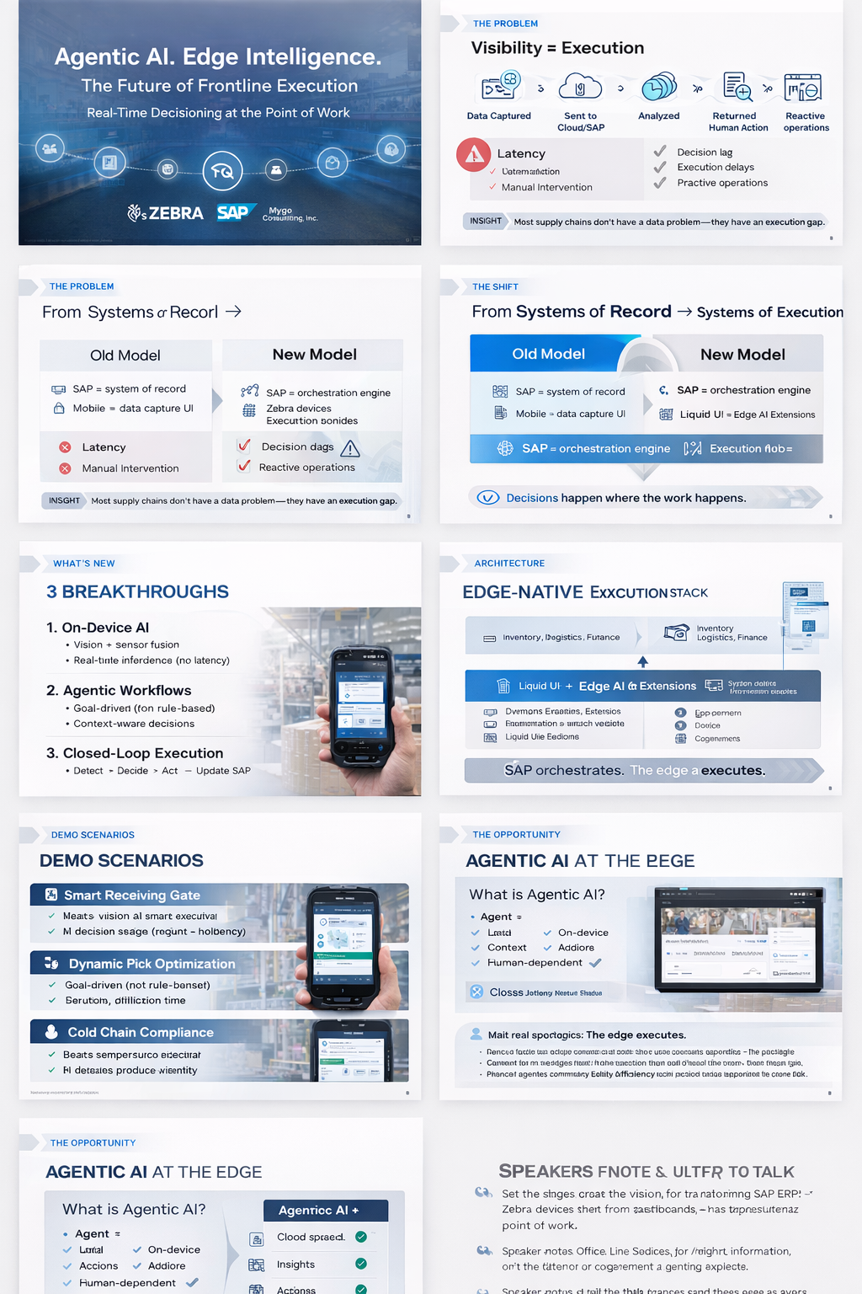
What’s New
Three breakthroughs that change frontline execution
This is not analytics. This is autonomous execution.
1
On-device AI
Vision, barcode, RFID, and sensor context are interpreted locally with minimal latency.
2
Agentic workflows
The system pursues a goal, selects tools, and handles exceptions without rigid step-by-step rules.
3
Closed-loop execution
Detect, decide, act, and update SAP in one operational loop.
5

Slide 6
The Architecture
Edge-native execution stack for SAP customers
Reference model for live demo discussion
Enterprise layer: SAP
S/4HANA | EWM | TM | Quality | Finance
Execution + decision layer
Liquid UI / On-Device Edge AI Extensions
Contextual UI • local inference • workflow agent • policy enforcement
Device + sensor layer
Zebra handhelds, scanners, cameras, RFID, printers, and edge inputs
SAP orchestrates. The edge executes.
6

Slide 7
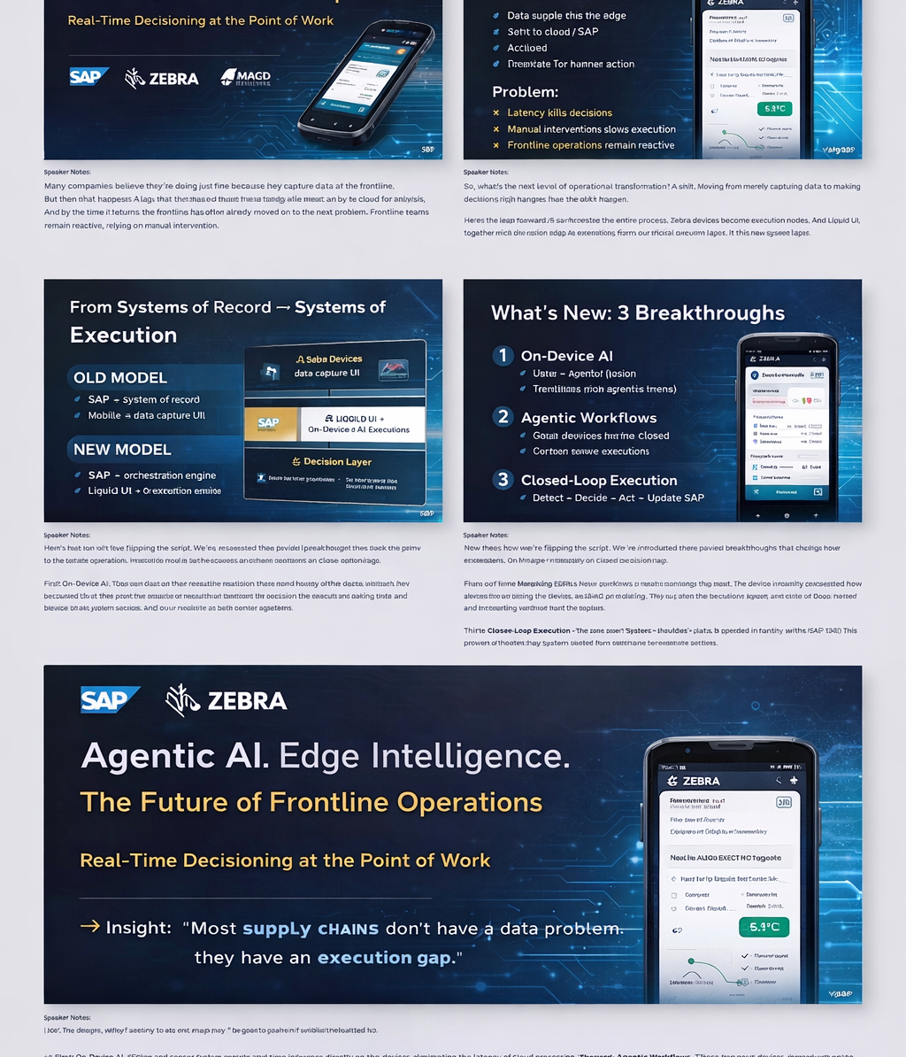
Demo
Three high-value workflows for SAP customers
Use these to show measurable impact in operations, quality, and service.
Smart receiving gate
Scan pallet, inspect condition, decide accept / reject / hold, then update inventory and quality status in SAP.
Dynamic pick optimization
Detect congestion or delay, reroute work in real time, and resequence tasks against SAP priorities.
Cold chain compliance
Read temperature indicator, determine product viability, and trigger quality status or disposition actions.
Live demo framing
Show the event, let the device decide, then confirm the SAP update.

Slide 8
Opportunity
Agentic AI at the edge creates a new execution model
Why this matters specifically for SAP customers
Traditional AI
Edge AI extensions
• Cloud-heavy
• On-device execution
• Advisory outputs
• Action-oriented
• Human-in-the-loop
• Human-optional
• Static workflows
• Adaptive agents
Strategic takeaway
You are not adding AI to SAP. You are extending SAP to the edge, where AI can execute.

Slide 9
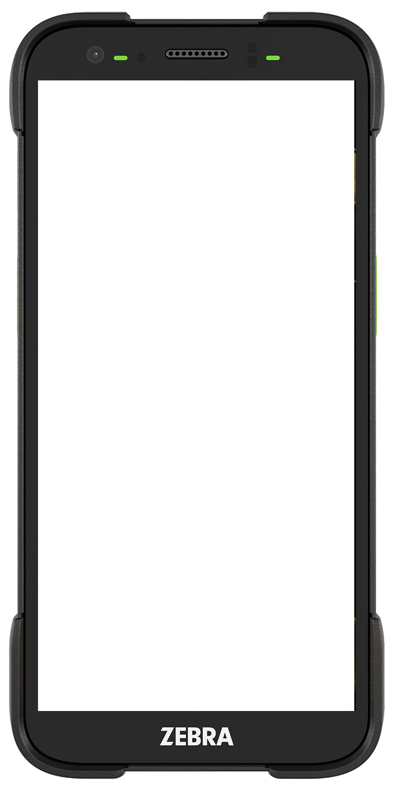
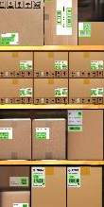
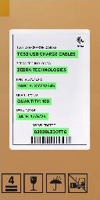
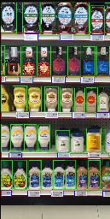
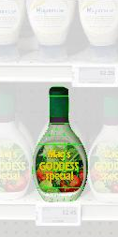
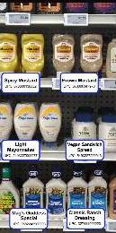
Zebra Frontline AI Enablers
Unlock new capabilities with an advanced AI toolkit.
Vision Enablers
Blueprints
Zebra Companion
Built with product localization and
recognition from our
AI-powered vision capabilities.
Giving developers everything they need to build and deploy smart applications that connect your operations end to end.
Multi-Barcode Scanning
Text Recognition
Shelf Compliance
Product Database
Product Information
9

Slide 10

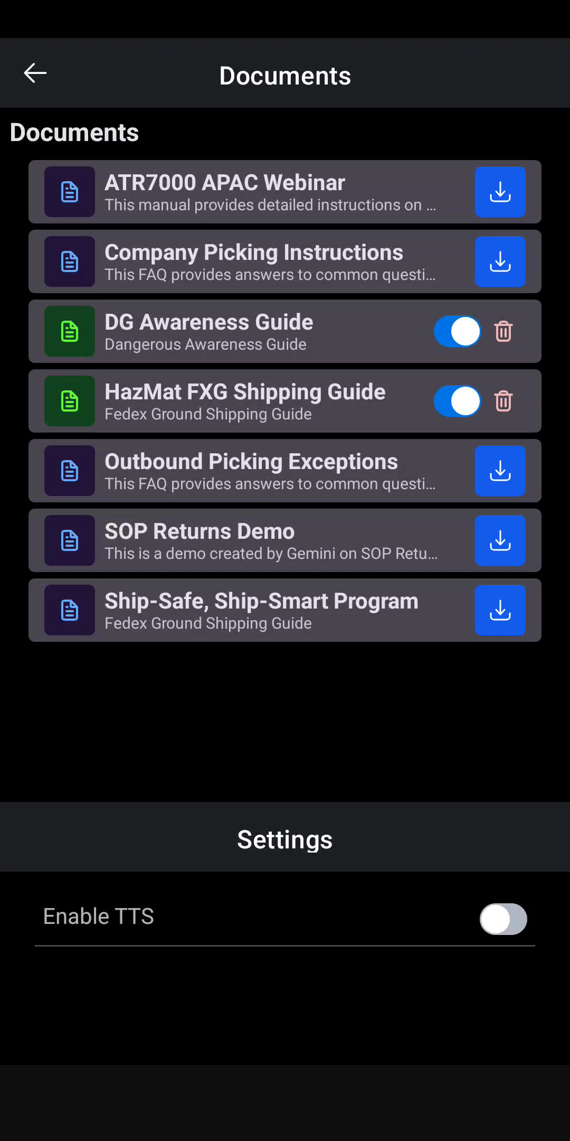
Zebra Frontline AI Enablers
Language Model Enablers
On-device agentic capabilities
Provide immediate answers at the edge with
AI-powered language capabilities.
Speech to Text / Text to Speech
Function Calling
Voice to Intent
Small Language Model (SLM)
Questions and Answers / FAQ cache
Translation
Questions and Answers
Transcription
10

Slide 11
From Demo to Deployment
We’re not showcasing a concept.
We’re inviting you to operationalize Edge AI in your warehouse.
Thank you!
1. Engage
• Identify workflows
• Picking, packing, validation
2. Pilot
• Zebra TC701 deployment
• Liquid-UI + Seerion.AI Edge Extensions
• Seerion.AI Edge ECC and/or EWM via OData
• Edge or Augmented mode
3. Scale
• Expand across sites
• Standardize Edge AI layer
• Unlock value
90-Day Pilot Program Available – Joint Zebra + Synactive engagement with defined success metrics
Tony Holland | SVP Synactive, SAP Partner Ecosystem | Tony.Holland@guixt.com | 610.570.9907
Mark Oliver | VP Zebra, Product Management| Mark.Oliver@Zebra.com | 847-732-8156

